Slide 1
VENDING MACHINE
BASAVESHWAR ENGINEERING COLLEGE(AUTONOMUS),
BAGALKOT
VERILOG CODE
BY : JAISHANTI
BY: PRATIKSHA PATIL

Slide 2
INTRODUCTION
A vending machine is a machine that dispenses items such as snacks - beverages, alcohol, cigarettes, lottery tickets, consumer products, and even gold and gems to customers automatically, after the customer inserts currency or credit into the machine.
Large-scale retailing is possible through vending machines by placing the machine at a convenient location such as petrol pumps ,railway stations airports etc. The buyer inserts a coin or token in the machine and receives a specific quantity of product from the machine.

Slide 3
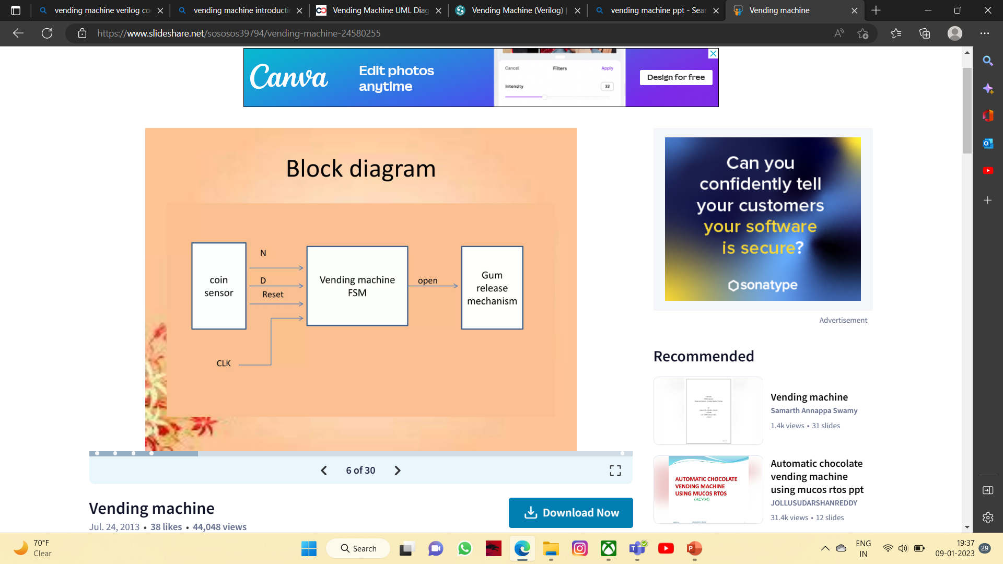
BLOCK DIAGRAM

Slide 4
ADVANTAGES
With the help of this machine ,factories are able to produce more to meet the demands in markets
Machine only require maintenance
They reduces the amount of money used to pay to workers and that money is used to service the machine
Machine can use for both domestic and industrial uses to make work easier
They give timely output with efficiency
Due to the fact that there is an increase in the amount of production the price goods and services reduced

Slide 5
DISADVANTAGES
Less communication between seller and customer
Resistance Risk of failing machines Coin fraud
Machine tend to replace the unskilled workers in the employment sector
Most of them are left idle and hey end up jobless
Machine especially those used in factories emits lot of greenhouse gases

Slide 6
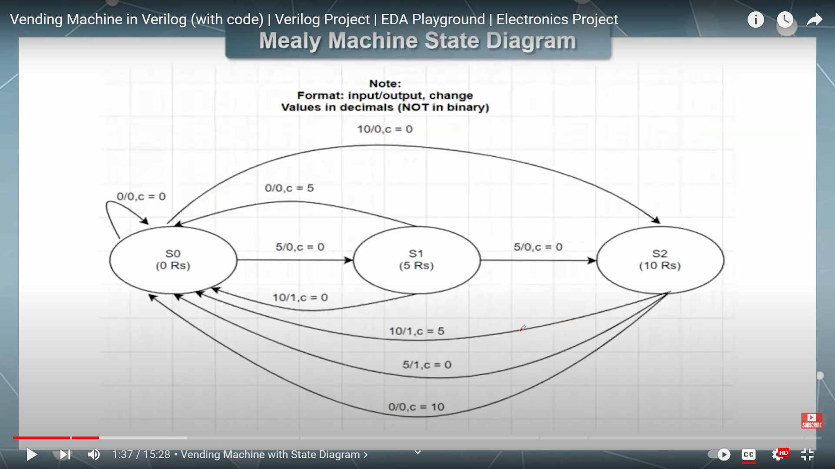
STATE DIAGRAM

Slide 7


